Slide 1
Student Dropout Analysis for School Education
Team ID: 653 PROBLEM ID : gh04
HACKATHON 2018(GRAND FINALE)

Slide 2

LOGO OF OUR WEB PORTAL

Slide 3
PROBLEM SOLUTION
First of all student will be enrolled using his/her unique Adhar-number.
After that the school will get all the related information regarding each student including unique Adhar-number which will be the primary key.
Through this Adhar-number, registered school , Government and any other stack-holder who interact with the system will be able to get all the information of the student according to there importance and role .
In our web-portal , we have inserted dummy data for study purpose to find feasible solutions of the problem.
Now whenever the student want to quit studies , he/she will be simply removed from the school database and this entry will be simply added into the master dropout table of government .

Slide 4
PROBLEM SOLUTION
The reason for dropout will be asked from the student who wish to quit studies , which will be helping government , to know that due to which reason major students are dropping out from there school .
Now there can be two major factors identifiable :A :- student will not get enrolled in any other school due to any reason . B : - Student will be migrated into another school after specific time period .
Now considering the first factor , after some time if a student want to continue his/her studies then in that school also Adhar-number of student will be asked and details of that student will be added into that specific school’s database in which the student is getting migrated and after that this entry of the migrating student will be removed from the master dropout table of government.

Slide 5
PROBLEM SOLUTION
In this way the government related to education department and other stakeholders associated with this system , will be kept updated with data of the student ( dropping out or migrating ) using Adhar-number as primary key .

Slide 6
Below given slide is including snapshots of admin side system .

Slide 7
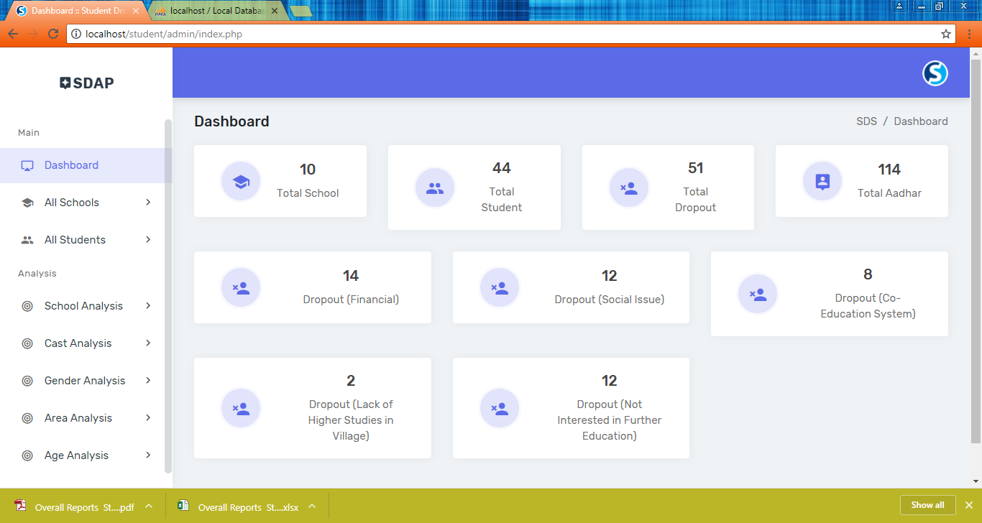

Slide 8
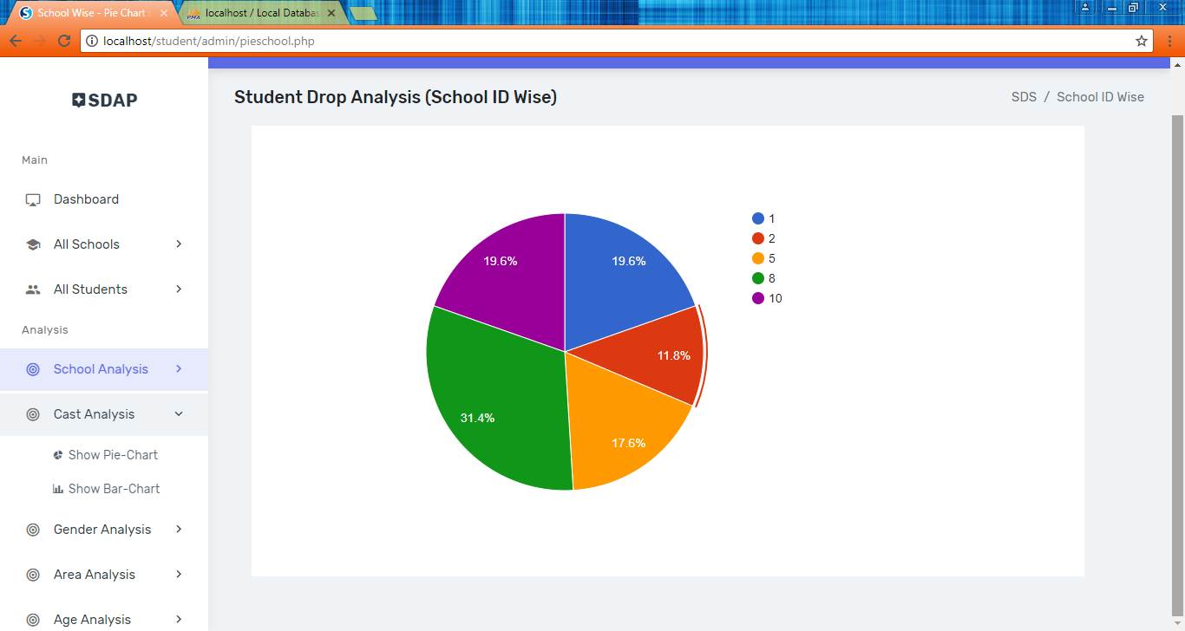
Analysis : -

Slide 9
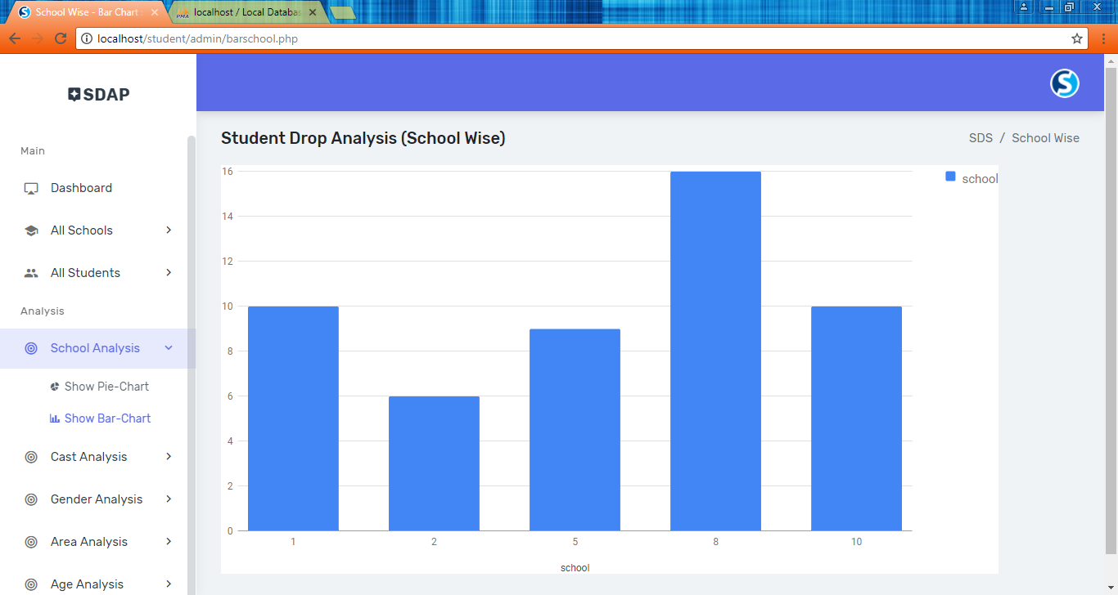

Slide 10
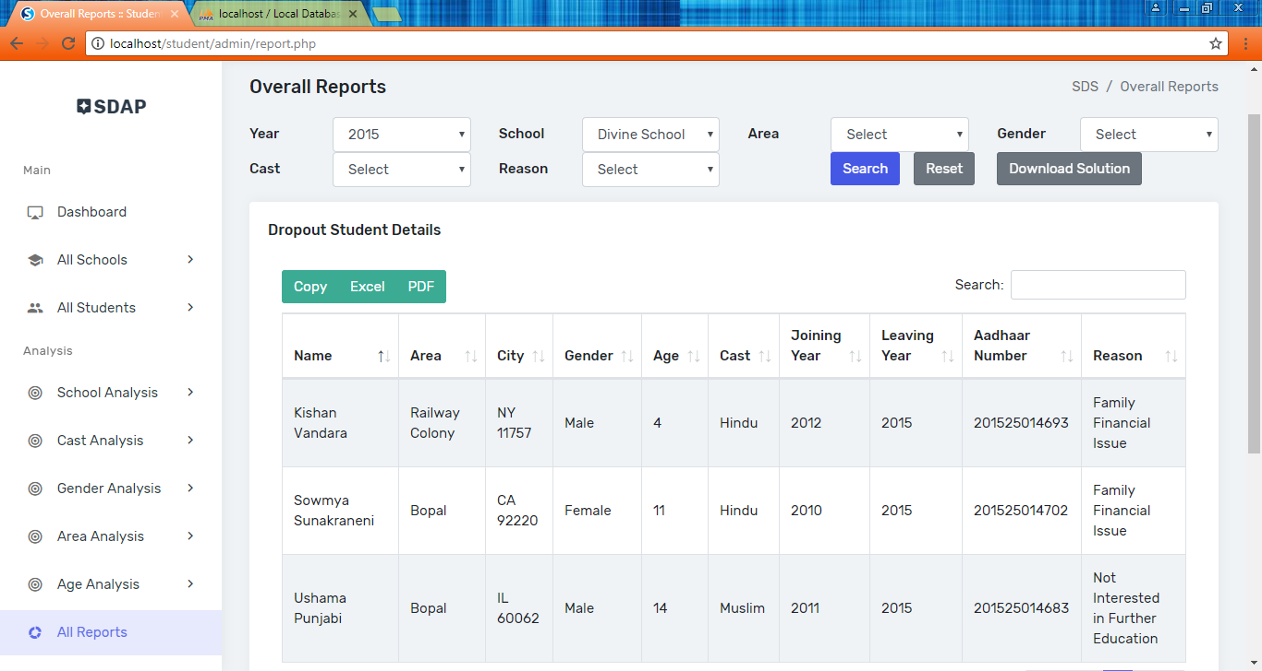

Slide 11
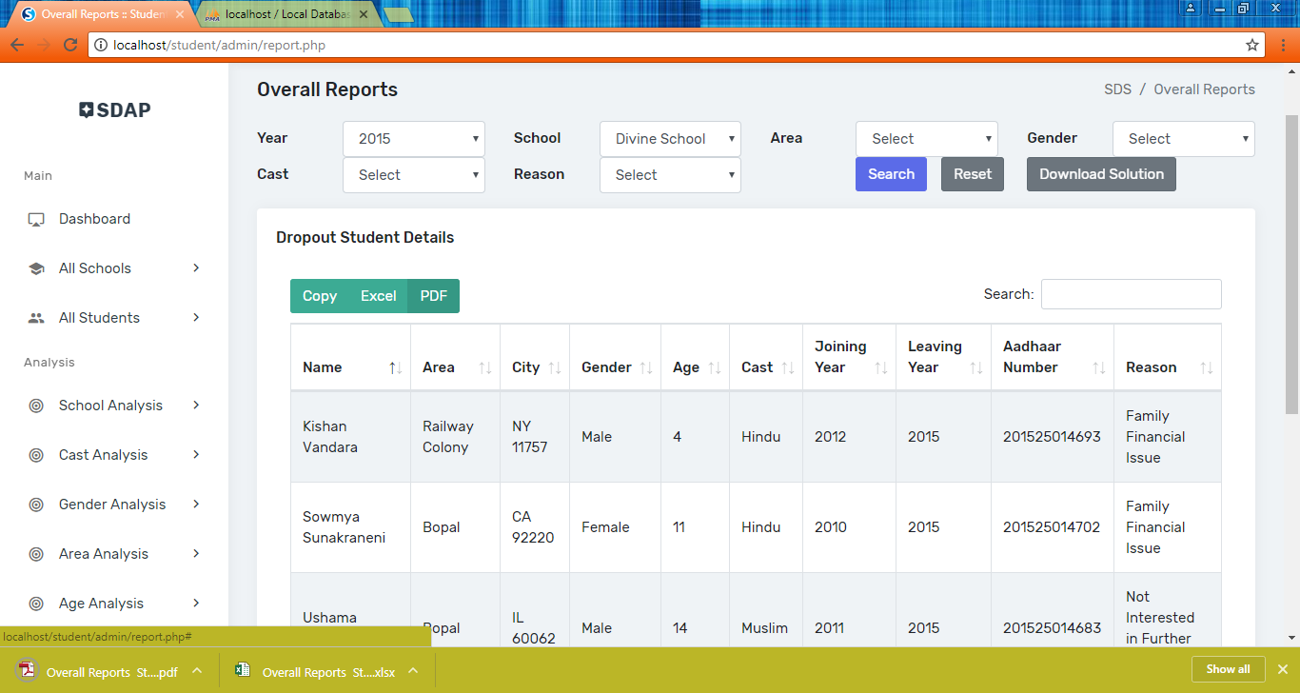

Slide 12
The end

